Slide 1
Java GUI Programming
Introduction

Slide 2


Graphical user interface (GUI)
  Presents a user-friendly mechanism for interacting with an application
  Often contains title bar, menu bar containing menus, buttons and combo boxes
  Built from GUI components

Slide 3
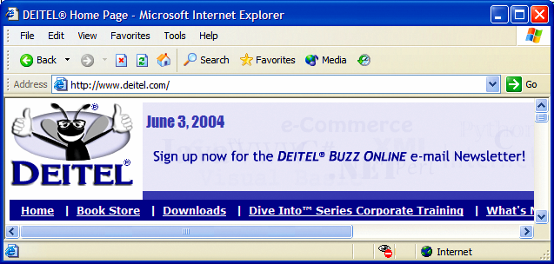
Graphical Components
button
menus
title bar
menu bar
combo box
scroll
bars

Slide 4

Simple GUI-Based Input/Output with JOptionPane
Dialog boxes
  Used by applications to interact with the user
  Provided by Java’s JOptionPane class
    Contains input dialogs and message dialogs

Slide 5
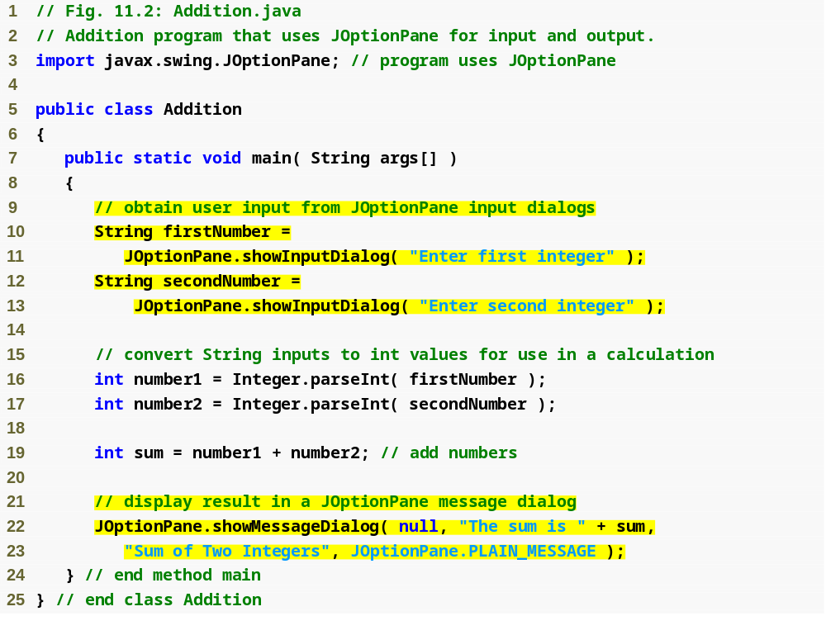
Outline
Show input dialog to receive first integer
Addition.java
(1 of 2)
Show input dialog to receive second integer
Show message dialog to output sum to user

Slide 6

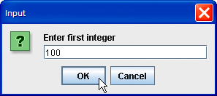
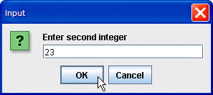
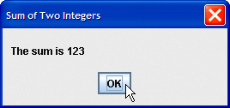
Outline
Input dialog displayed by lines 10–11
Prompt to the user
Text field in which
the user types a
value
When the user clicks OK,
showInputDialog returns to the program the 100 typed by the user as a String. The program must convert the String to an int
Addition.java
(2 of 2)
Input dialog displayed by lines 12–13
title bar
Message dialog displayed by lines 22–23
When the user clicks OK, the
message dialog is dismissed (removed from the screen)

Slide 7
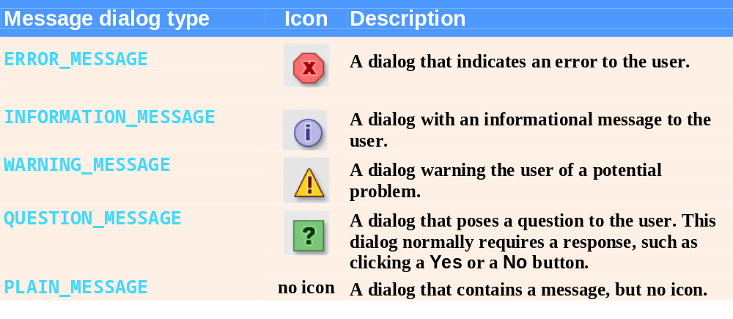
Fig. 11.3 | JOptionPane static constants for message dialogs.

Slide 8
11.3 Overview of Swing Components
Swing GUI components
  Declared in package javax.swing
  Most are pure Java components
  Part of the Java Foundation Classes (JFC)

Slide 9
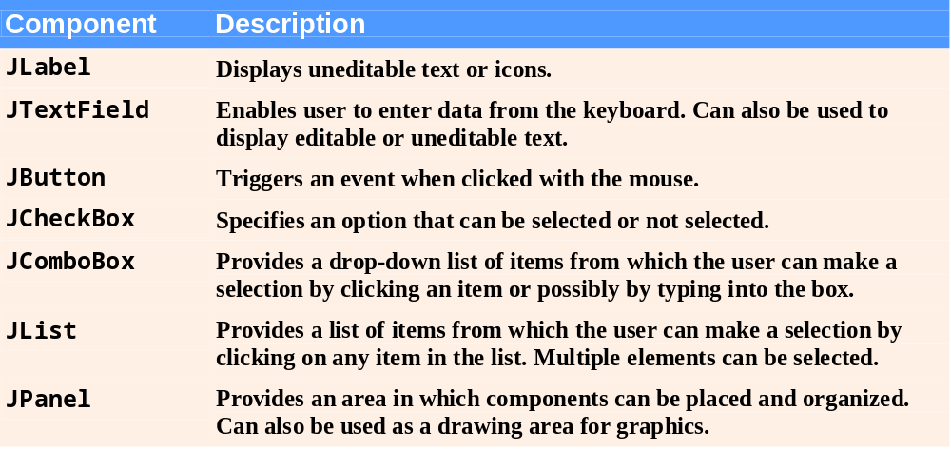


Slide 10
Swing vs. AWT
Abstract Window Toolkit (AWT)
  Precursor to Swing
  Declared in package java.awt
  Does not provide consistent, cross-platform look-and-feel

Slide 11
Portability Tip 11.1
Swing components are implemented in Java, so they are more portable and flexible than the original Java GUI components from package java.awt, which were based on the GUI components of the underlying platform. For this reason, Swing GUI components are generally preferred.

Slide 12
Lightweight vs. Heavyweight GUI Components
Lightweight components
  Not tied directly to GUI components supported by underlying platform
Heavyweight components
  Tied directly to the local platform
  AWT components
  Some Swing components

Slide 13
Superclasses of Swing’s Lightweight GUI Components
Class Component (package java.awt)
  Subclass of Object
  Declares many behaviors and attributes common to GUI components
Class Container (package java.awt)
  Subclass of Component
  Organizes Components
Class JComponent (package javax.swing)
  Subclass of Container
  Superclass of all lightweight Swing components

Slide 14
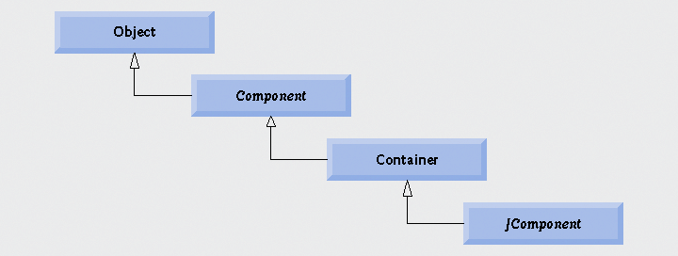

Slide 15
Superclasses of Swing’s Lightweight GUI Components
Common lightweight component features
  Pluggable look-and-feel to customize the appearance of components
  Shortcut keys (called mnemonics)
  Common event-handling capabilities
  Brief description of component’s purpose (called tool tips)
  Support for localization

Slide 16
Windowing

Slide 17
Lightweight vs. Heavyweight GUI Components
Lightweight components
  Not tied directly to GUI components supported by underlying platform
  Swing
Heavyweight components
  Tied directly to the local platform
  AWT components
  Some Swing components

Slide 18
Displaying Text and Images in a Window
Class JFrame
  Most windows are an instance or subclass of this class
  Provides title bar
  Provides buttons to minimize, maximize and close the application

Slide 19
Labeling GUI Components
Label
  Text instructions or information stating the purpose of each component
  Created with class JLabel

Slide 20
Specifying the Layout
Laying out containers
  Determines where components are placed in the container
  Done in Java with layout managers
    One of which is class FlowLayout
  Set with the setLayout method of class JFrame

Slide 21
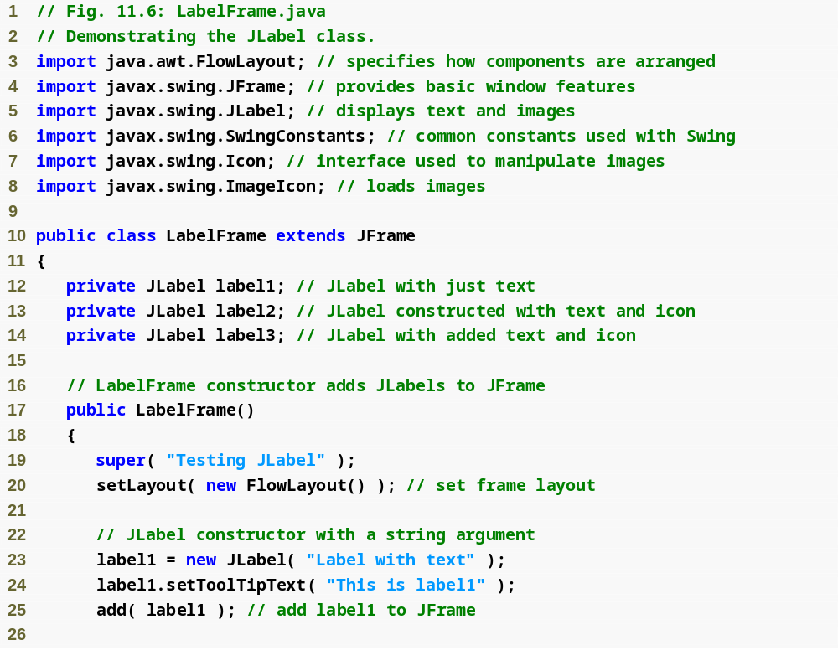
Outline
LabelFrame.java
(1 of 2)

Slide 22
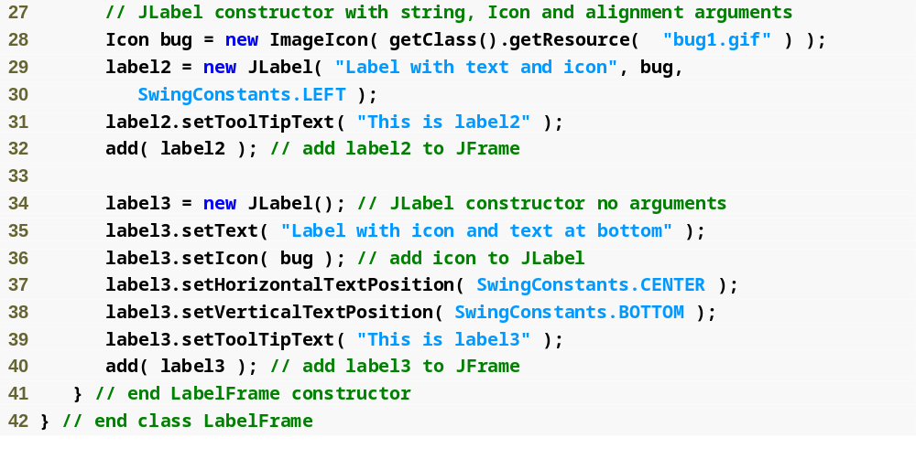
Outline
LabelFrame.java
(2 of 2)

Slide 23
Creating and Attaching label1
Method setToolTipText of class JComponent
  Specifies the tool tip
Method add of class Container
  Adds a component to a container

Slide 24
Creating and Attaching label2
Interface Icon
  Can be added to a JLabel with the setIcon method
  Implemented by class ImageIcon
Interface SwingConstants
  Declares a set of common integer constants such as those used to set the alignment of components
  Can be used with methods setHorizontalAlignment and setVerticalAlignment

Slide 25
Creating and Attaching label3
Other JLabel methods
  getText and setText
    For setting and retrieving the text of a label
  getIcon and setIcon
    For setting and retrieving the icon displayed in the label
  getHorizontalTextPosition and setHorizontalTextPosition
    For setting and retrieving the horizontal position of the text displayed in the label

Slide 26
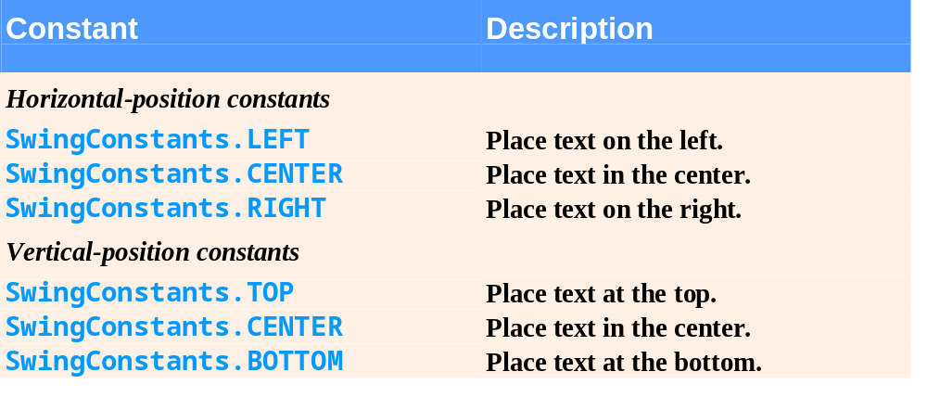
Fig. 11.8 | Some basic GUI components.

Slide 27
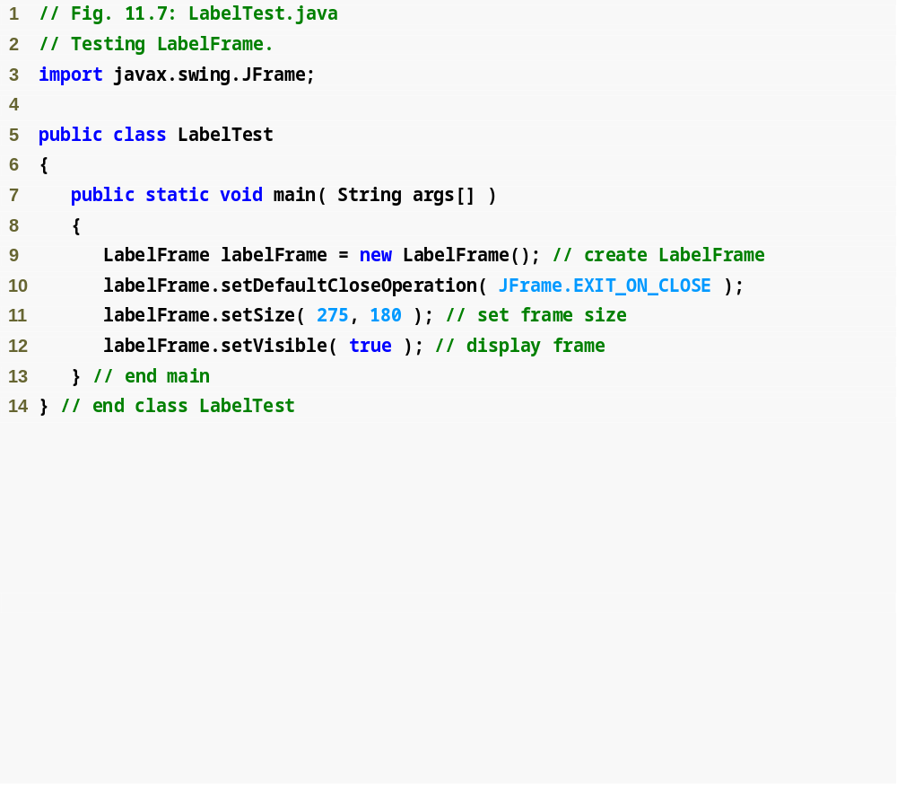
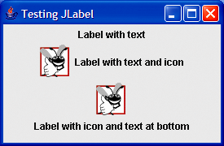
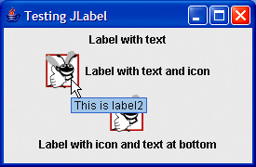
Outline
LabelTest.java

Slide 28
Creating and Displaying a LabelFrame Window
Other JFrame methods
  setDefaultCloseOperation
    Dictates how the application reacts when the user clicks the close button
  setSize
    Specifies the width and height of the window
  setVisible
    Determines whether the window is displayed (true) or not (false)

